Slide 1
The Transforming Alice A Literature and Its Story
Zhu Xinwei
Department of Literature, Film and Theatre Studies
University of Essex

Slide 2
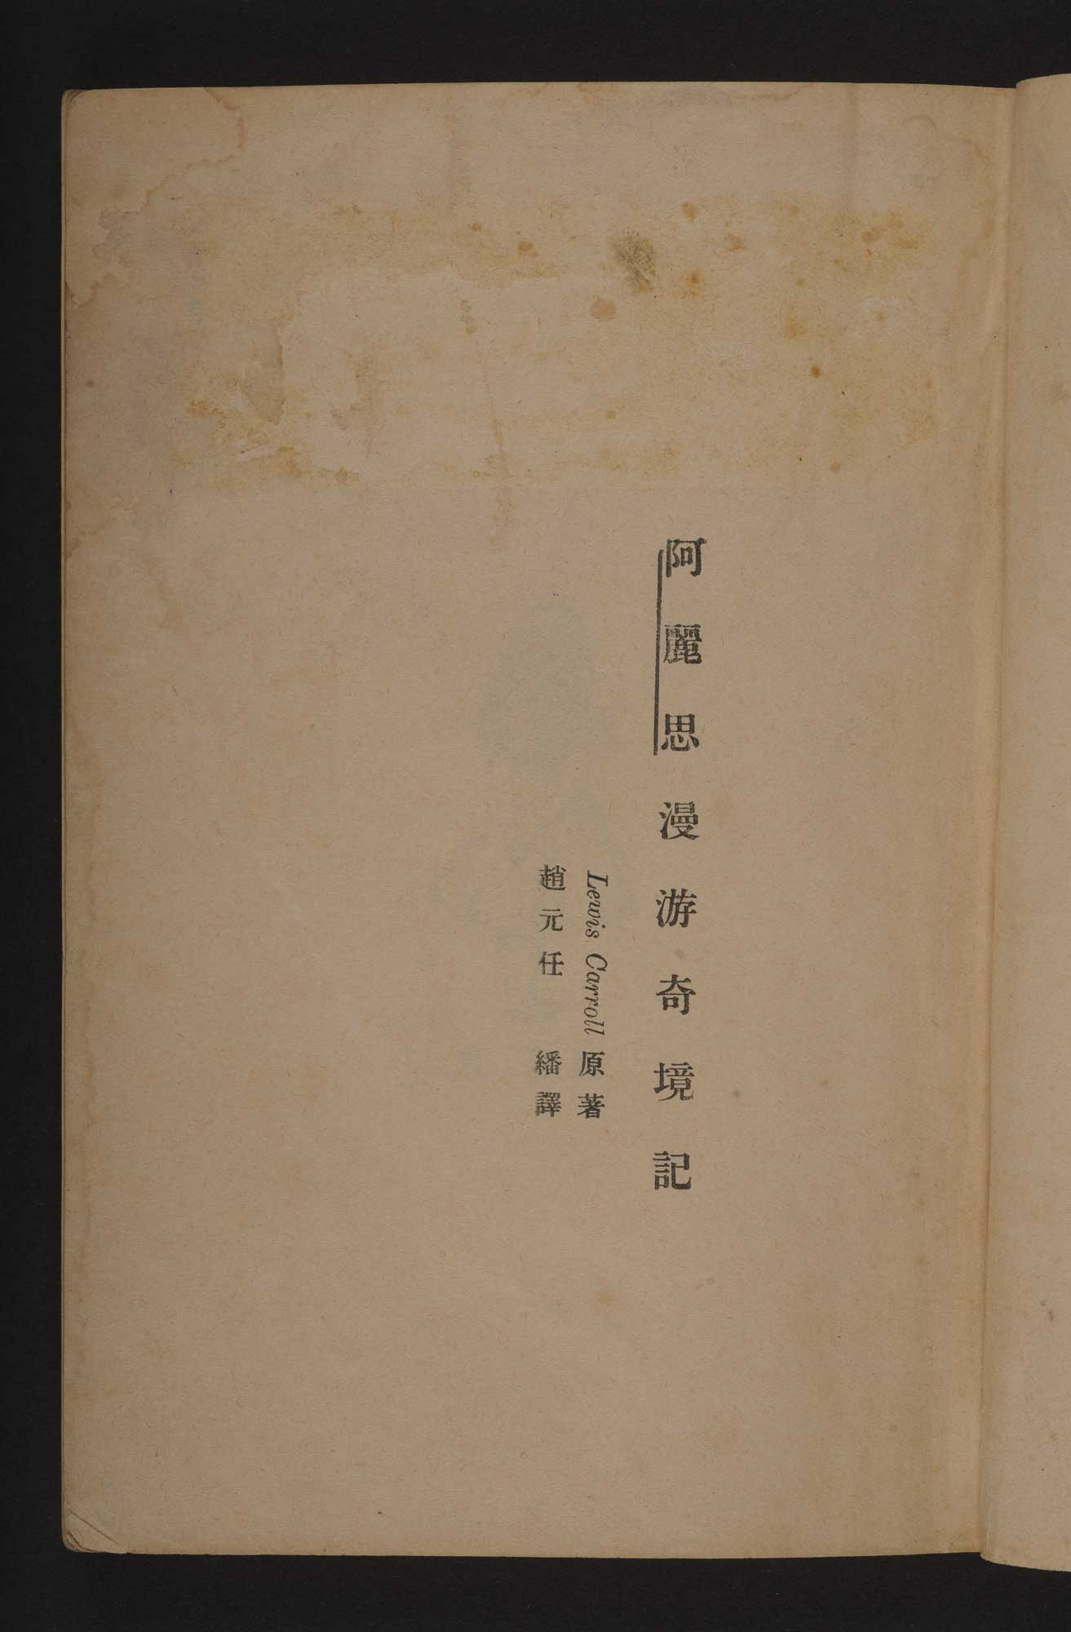

Slide 5
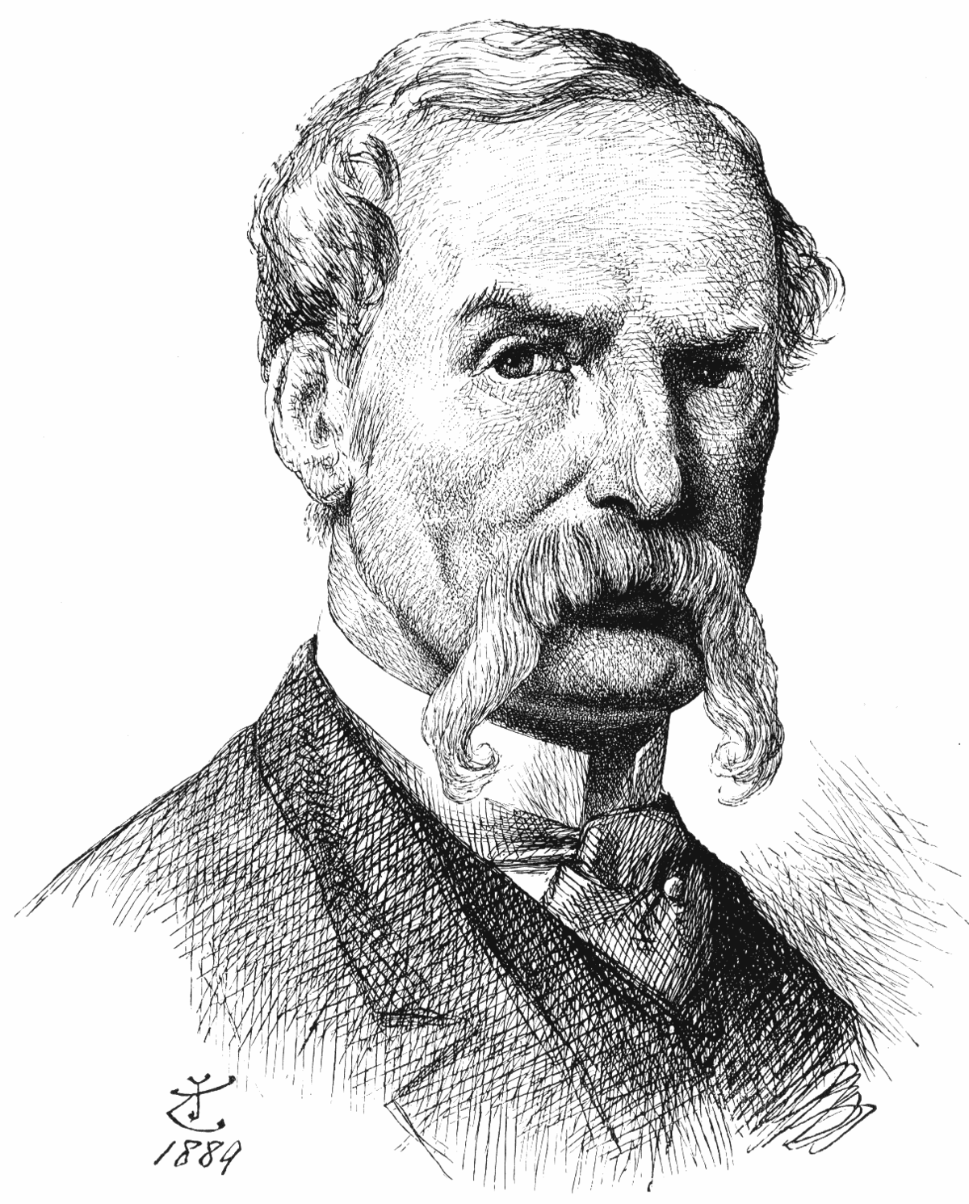

Slide 6
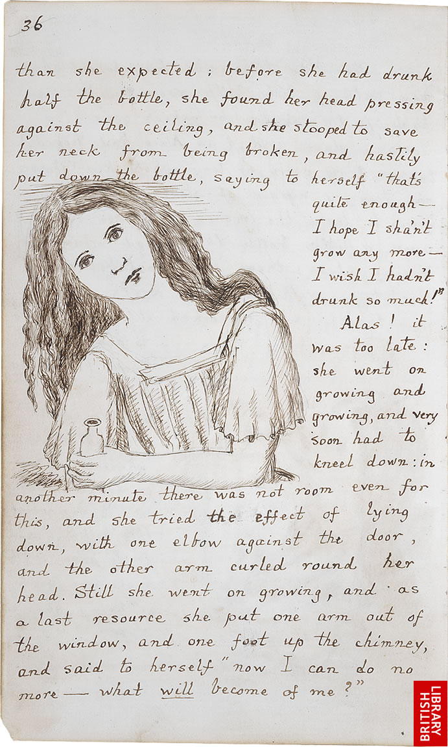

Slide 7
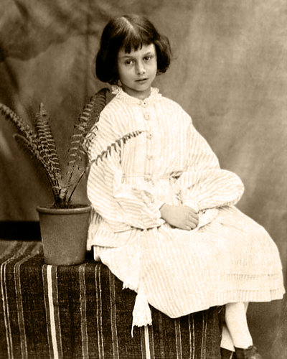

Slide 9
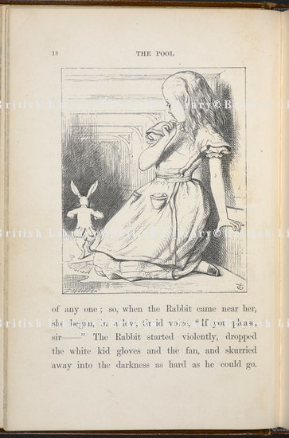

Slide 10
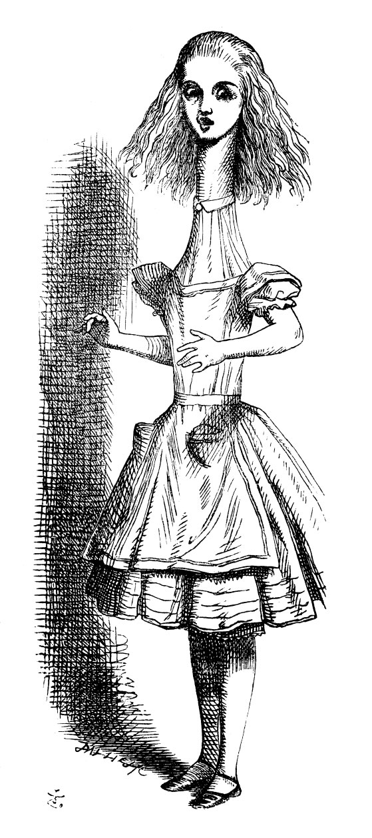

Slide 14
The Ugly Duchess
The Grotesque Old Woman
Quentin Matsys
Oil on Oak Panel
1513

Slide 18
Alice in Wonderland
Oil on canvas
George Dunlop Leslie (1835-1921)
1879

Slide 19
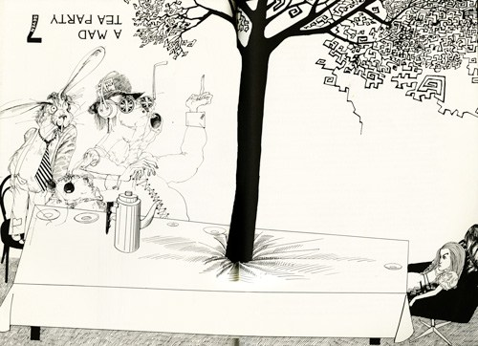

Slide 22
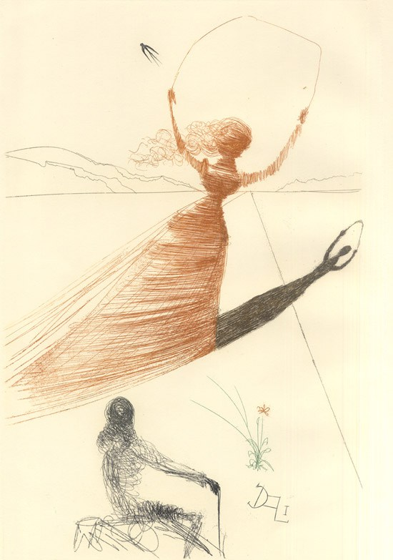

Slide 23
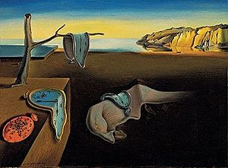

Slide 28
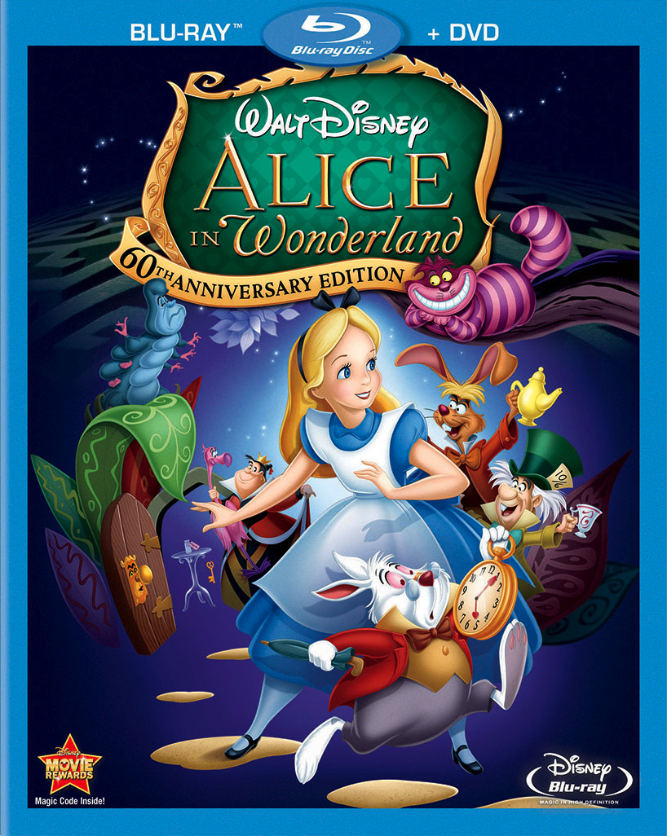

Slide 29
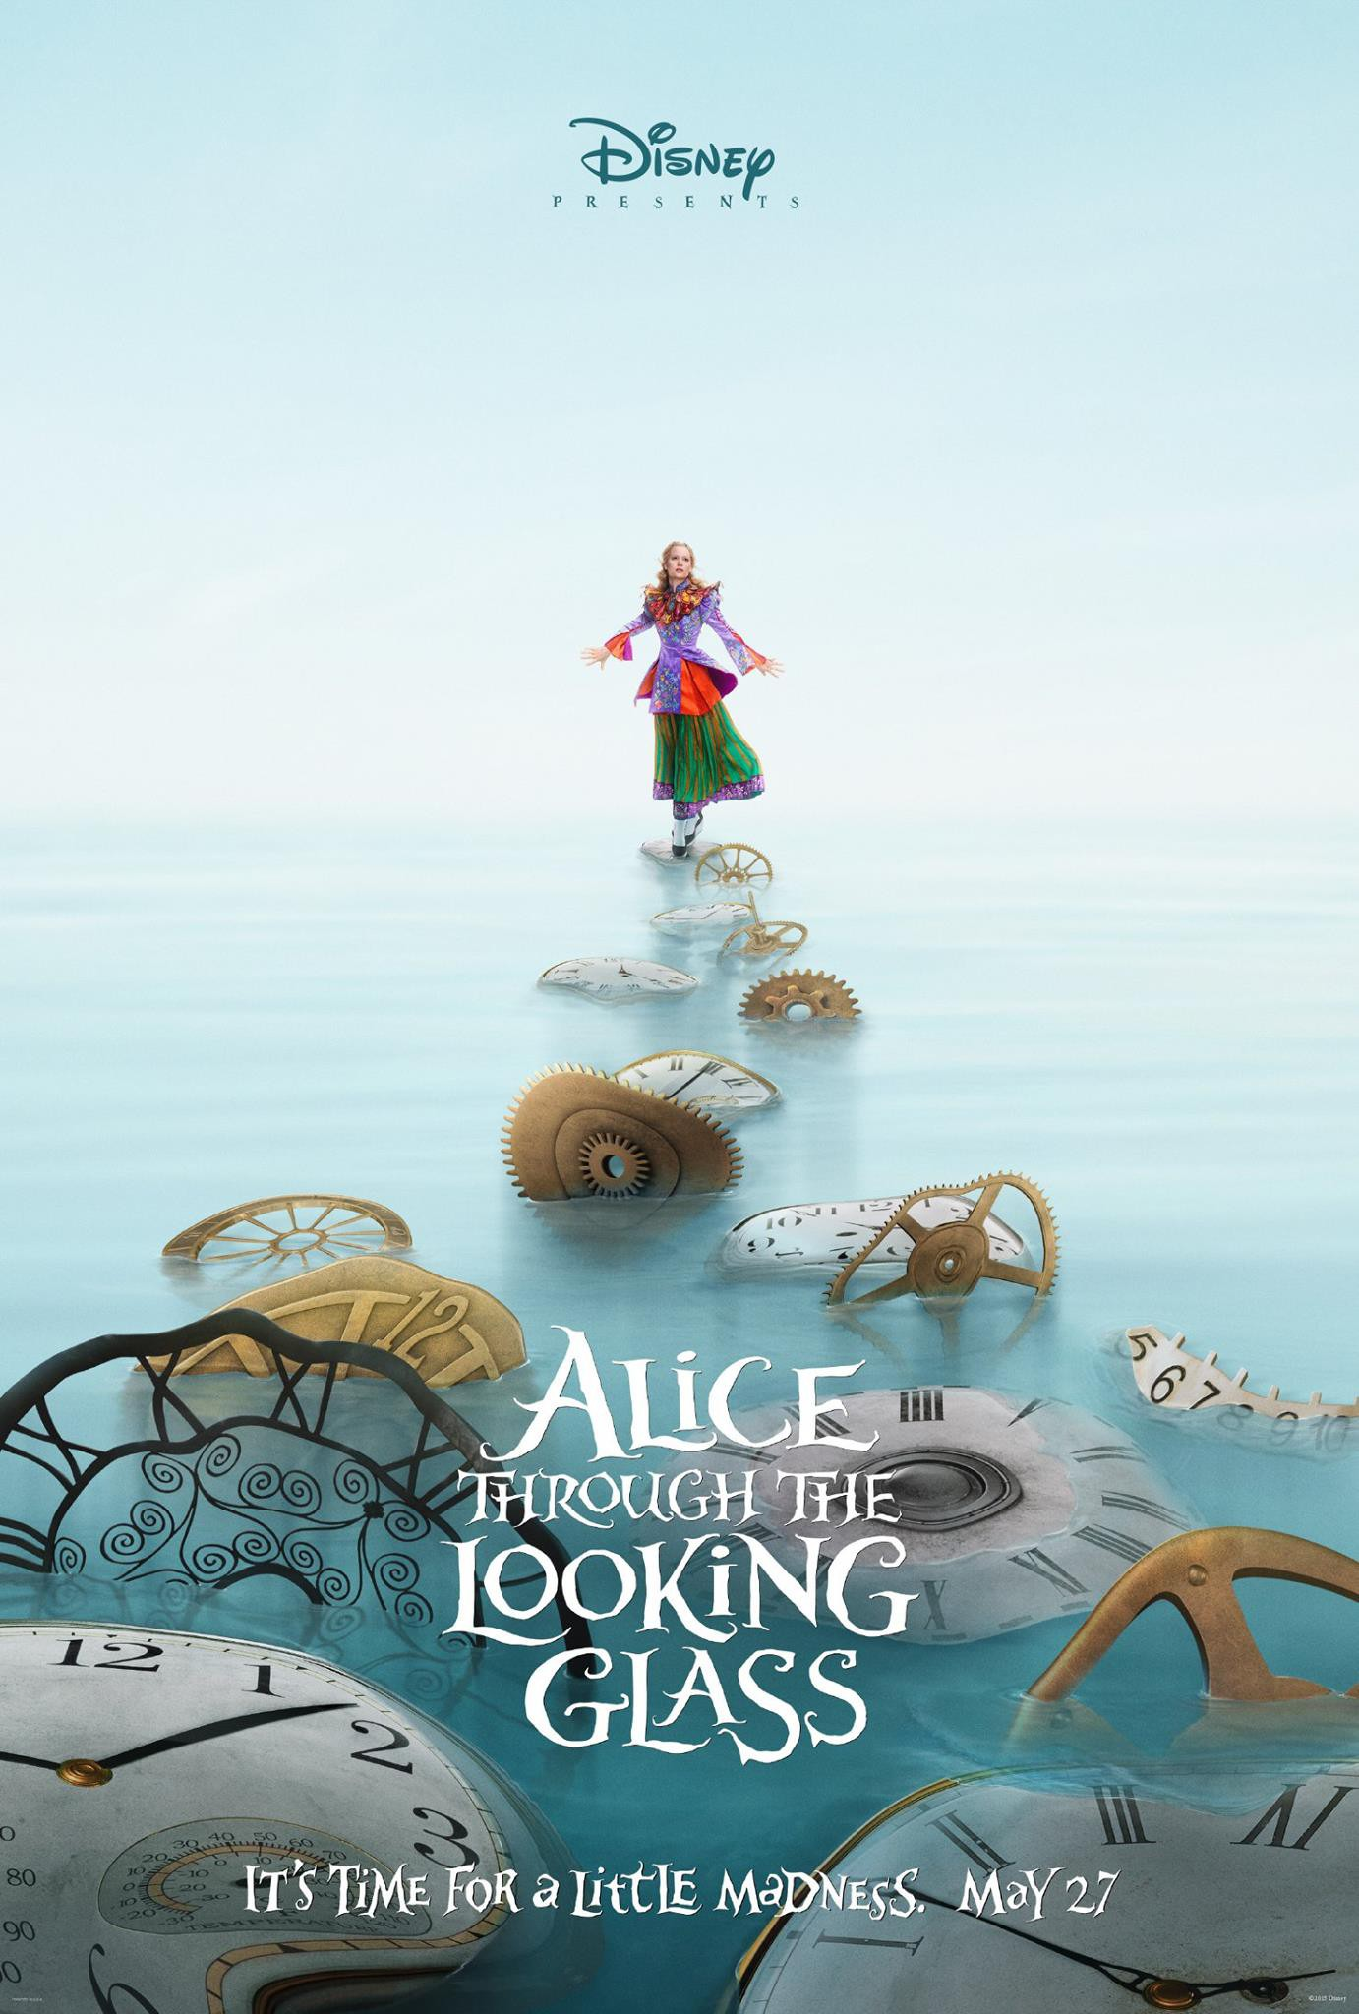

Slide 30
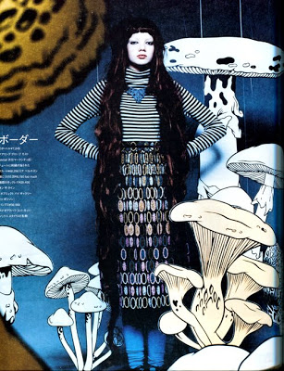
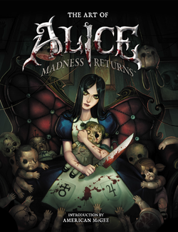

Slide 31
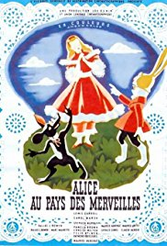

Slide 32
Alice in Wonderland 1903: https://www.youtube.com/watch?v=zeIXfdogJbA

Slide 33
https://www.youtube.com/watch?v=tIFEIVkYSnw&pbjreload=10

Slide 34
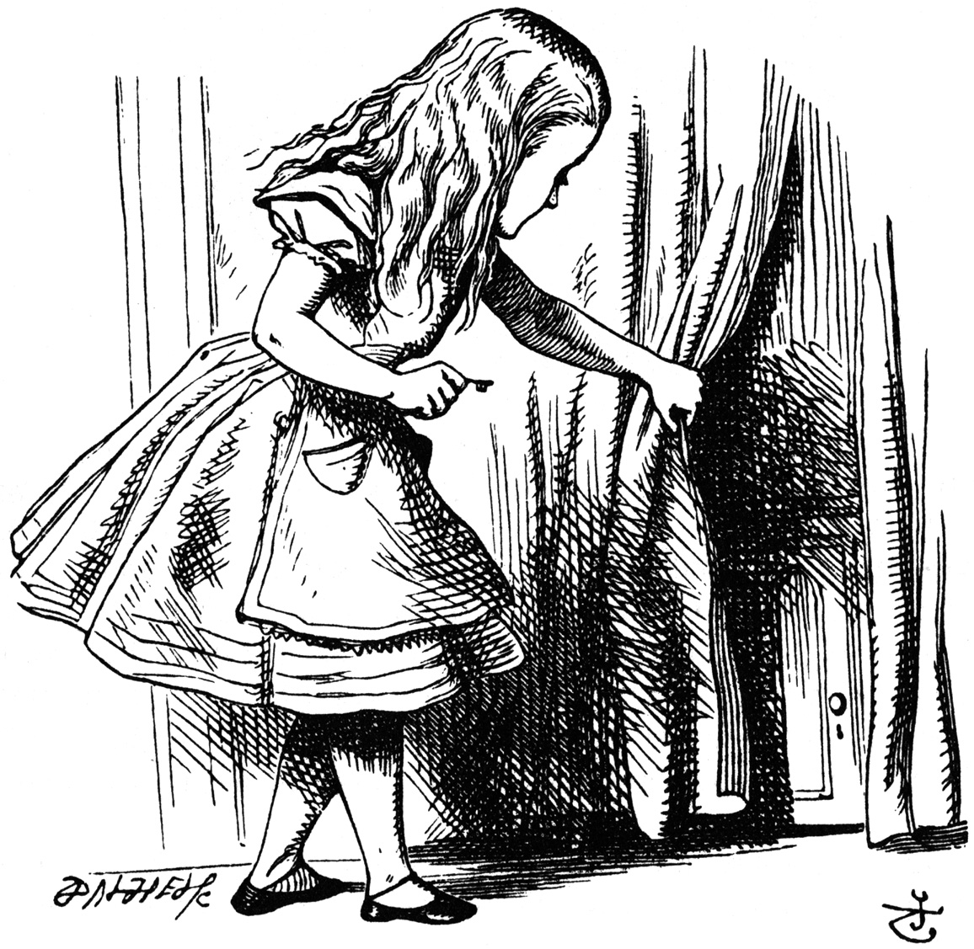
Alice in Wonderland (1931) https://www.youtube.com/watch?v=AbeNblCjQ7c&t=17s&pbjreload=10
Alice (1988) https://www.youtube.com/watch?v=3MLafk3imk4
Alice in Wonderland (1966) http://www.dailymotion.com/video/xg8sb3

