Slide 1
第二十三期：体育舞蹈赏析
主讲人：顾佳腾
21.10.2017

Slide 2
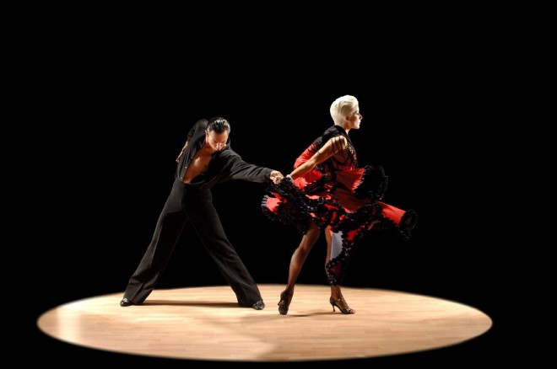
Dancesport
Waltz
Quickstep
Foxtrot
Tango
Viennese Waltz
Cha Cha
Samba
Rumba
Jive
Paso Doble

Slide 3
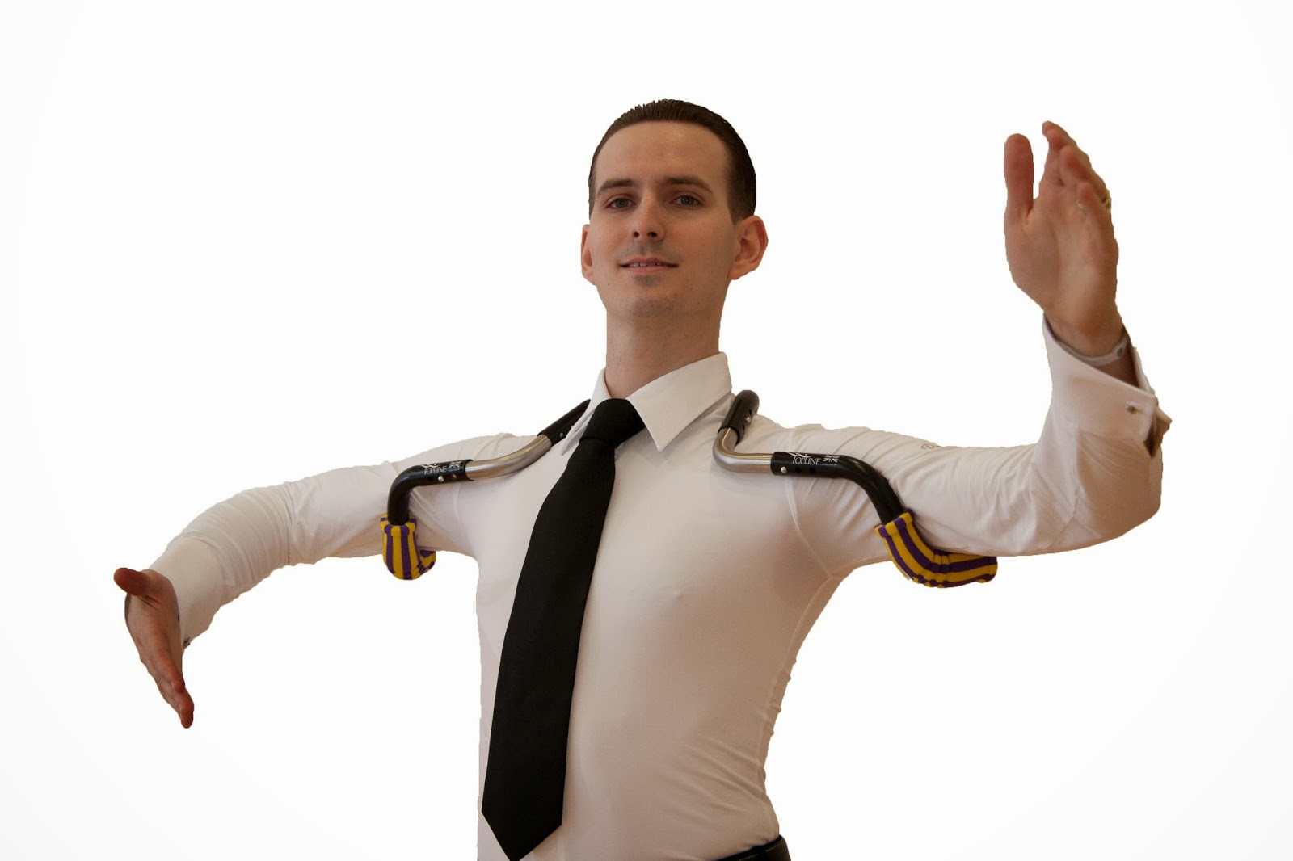

Slide 6
Mirko Gozzoli & Alessia Betti

Slide 7
来来来！看视频！
https://www.youtube.com/watch?v=8hprFQZQHlM&t=334s
https://www.youtube.com/watch?v=KcBop6cQV_k
https://www.youtube.com/watch?v=nwbEF4WkDIs
https://www.youtube.com/watch?v=gR0vrzdv6bM

Slide 8
终于可以讲拉丁了
拉丁舞的起源
姿势很不一样
漂洋过海 和战后发展
50-70 年代
https://www.youtube.com/watch?v=rhfP5fCr5Jo
https://www.youtube.com/watch?v=pg6F3M39AHs

Slide 9
江山辈有人才出 各领风骚好多年
Donnie Burns, MBE & Gaynor Fairweather, MBE
https://www.youtube.com/watch?v=ncSB_4AyPUo

Slide 10
江山辈有人才出 各领风骚好多年

Slide 11
江山辈有人才出 各领风骚好多年

Slide 12
如何去塑造美
形体的美
节奏的美
https://www.youtube.com/watch?v=IL-29pF6SNo&index=35&list=WL
对比的美

Slide 13
Cheeky Cha Cha Cha
男女激情互撩 （不然和广场舞有什么区别）
2-3-4-n-1
https://www.youtube.com/watch?v=ujEtJbANp4o&index=36&list=WL
https://www.youtube.com/watch?v=Qa0mHlbYpKk&index=10&list=FL7bTXCtfbTOgj3uFwLXf4Bw

Slide 14
Samba
狂欢的舞蹈，热情奔放
3-quarter-quarter – 1
Bounce
https://www.youtube.com/watch?v=HUXxfHVNfwY&index=5&list=FL7bTXCtfbTOgj3uFwLXf4Bw%00&t=220s
https://www.youtube.com/watch?v=UuHG1C0l0SM

Slide 15
Rumba
故事讲述版本比较多。。。
Rumba walk
距离的对比
速度的对比
https://www.youtube.com/watch?v=4hpE16t4niI
MJ 2008
https://www.youtube.com/watch?v=Ny-6icH9t9Y&index=41&list=WL

Slide 16
Jive
出去游玩享乐
Bounce
钟摆
https://www.youtube.com/watch?v=fhj4dvDZKec
https://www.youtube.com/watch?v=9MF1REzg7GQ
https://www.youtube.com/watch?v=gB6rzH0uCLY

Slide 17
Paso Doble
8 8 8 8 4
8 8 8 8 8 8 4 (1st highlight)
8 10 8 6 8 8 8 8 6 (2nd highlight)
8 8 8 8 8 8 8 8 8 5 8 (3rd highlight)
新月造型
Lead
https://www.youtube.com/watch?v=GQilpRCb1ss
https://www.youtube.com/watch?v=Ov4xcHf4Sbo&index=39&list=WL

Slide 18
Show Dance
https://www.youtube.com/watch?v=WlKFTkBQFTQ

