Slide 1
Ashmolean博物馆的今生前世

Slide 2
世界上第一家公立博物馆
最大的大学博物馆
近代博物馆的鼻祖

Slide 3
International Council Of Museum
A museum is a non-profit, permanent institution in the service of society and its development, open to the public, which acquires, conserves, researches, communicates and exhibits the tangible and intangible heritage of humanity and its environment for the purposes of education, study and enjoyment.

Slide 4
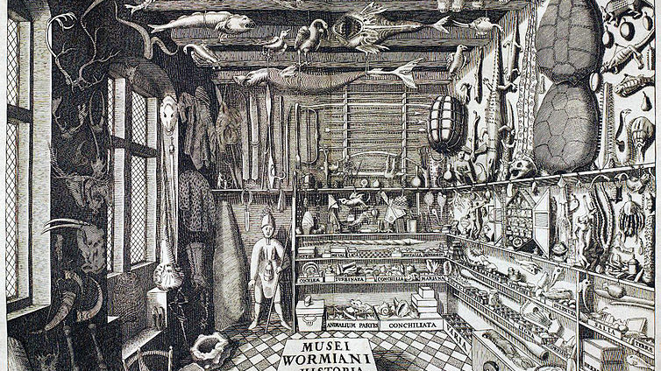
早期博物馆
Cabinet of Curiosities 珍奇屋
上流人士的专属
高逼格的炫耀

Slide 5
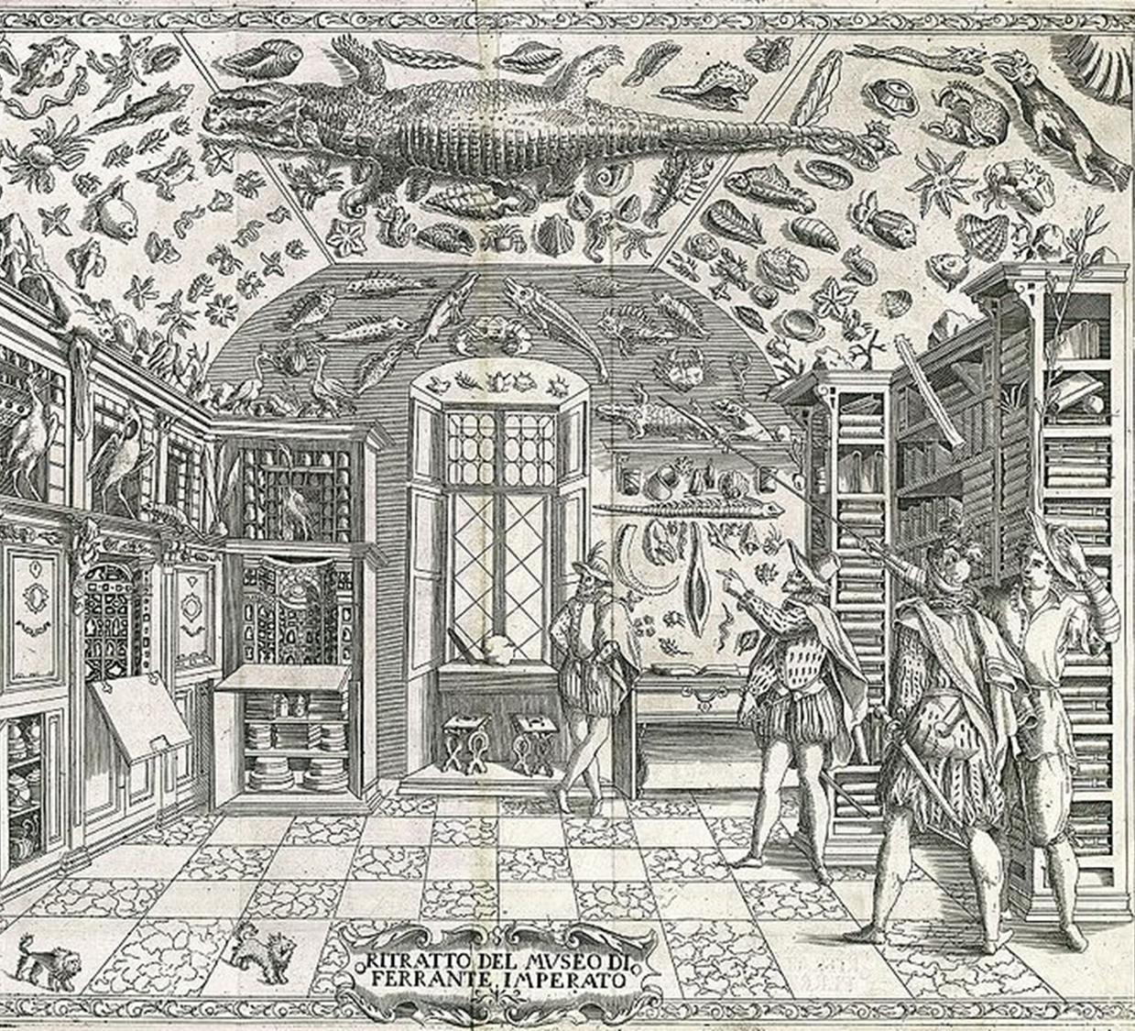
最早的珍奇屋图像记录来自1599年那不勒斯药剂师Ferrante Imperato出版的 Dell‘Historia Naturale (History of Nature)

Slide 6
Elias Ashmole
Politician
Officer of Arms
The Founding Fellow of the Royal Society
An Early Freemason
Founder of the Ashmolean Museum

Slide 7
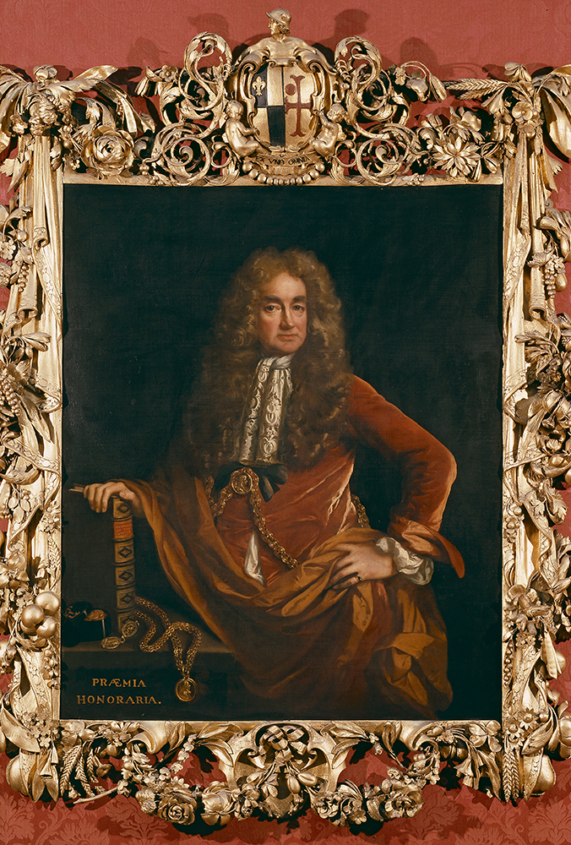
Elias Ashmole
A Lichfield saddler’s son
Lichfield Grammar School
3 Marriages
The Royalist
Social climber
Liar?
Murder?

Slide 8
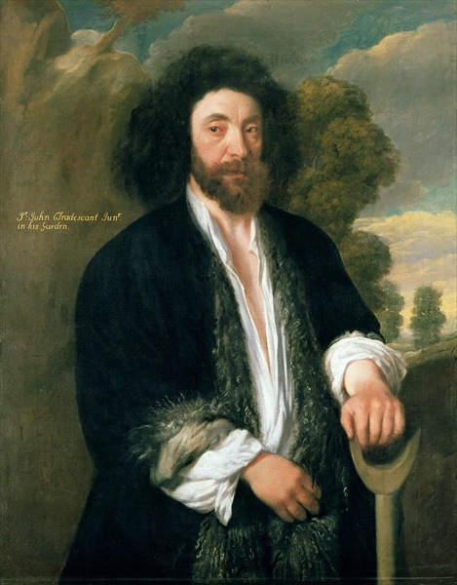
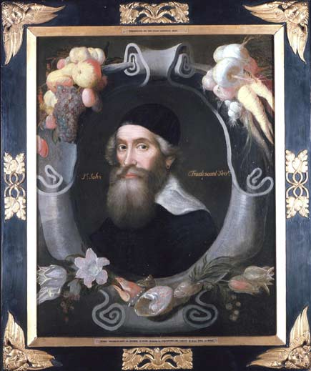
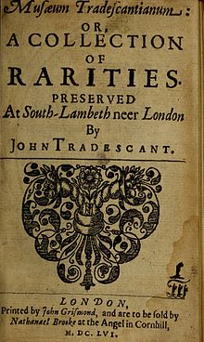
The Tradescants
John Tradescant the Elder (1570 –1638) John Tradescant the Younger (1608 –1662) Naturalist, Gardener, Traveller, Collector
The Ark A collection of rare and strange objects House in Lambeth, London (Tradescant Road) The first museum open to the public in England
Musaeum Tradescantianum Books, coins, weapons, costumes, taxidermy, and other curiosities
Other contribution Introduced American plants to English garden, such as Magnolias(木兰), Bald Cypress (落羽杉), Tulip tree (鹅掌楸), Phlox (福禄考) and Asters (紫苑).

Slide 9
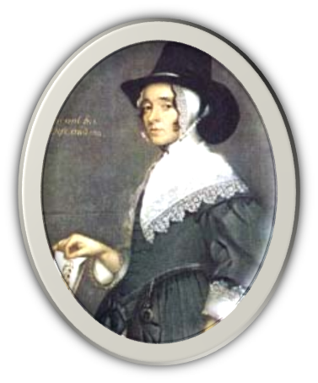
Hester Pooks
John Tradescant the Younger’s second wife
The Tradescants’ house at Lambeth in south London

Slide 10
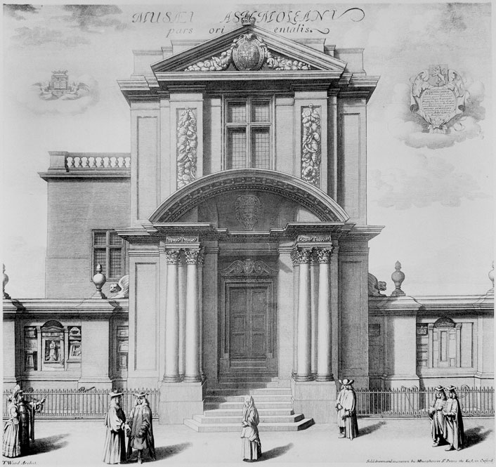
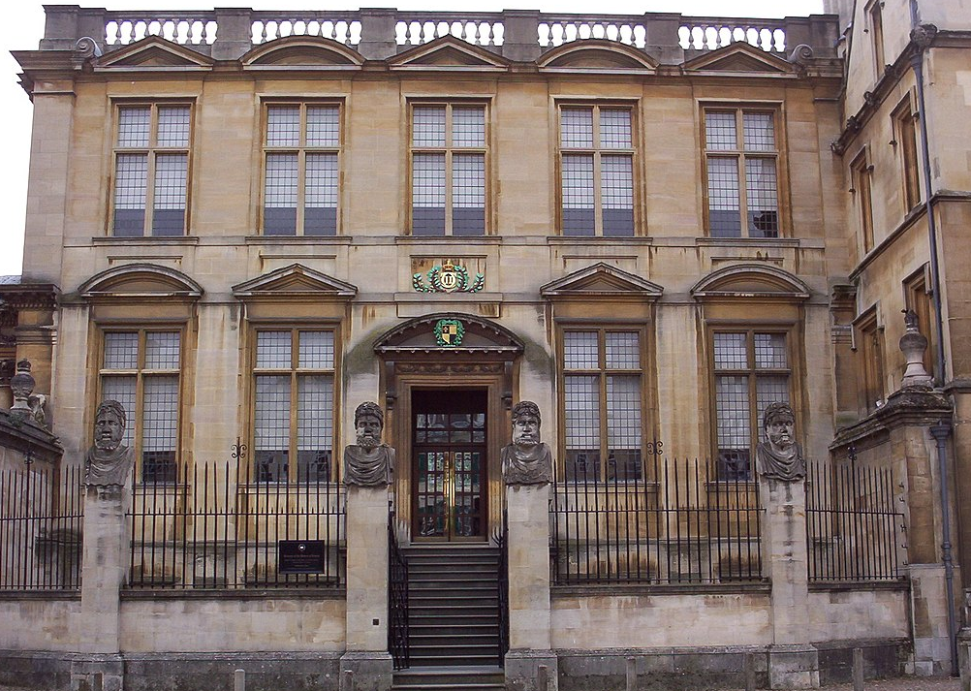
Old Ashmolean Opened on 21st May 1683 by Duke of York Broad Street Admission fee: Sixpences
Museum of the History of Science

Slide 11
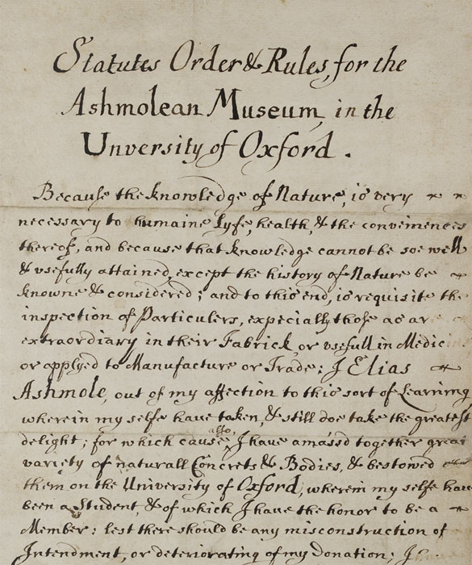
Statues Orders & Rules for the Ashmolean Museum 1683

Slide 12
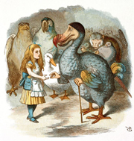
Decay and Loss
In the mid 18th century an audit of the Ashmolean collections revealed the extent of decay and loss of original specimens.
Bye the Oxford Dodo 1755 moth-eaten the last Dodo in Europe Only the head and a claw now remain
Iconic representations Sir John Tenniel illustrated Lewis Carroll’s Alice's Adventures in Wonderland in 1865.

Slide 13
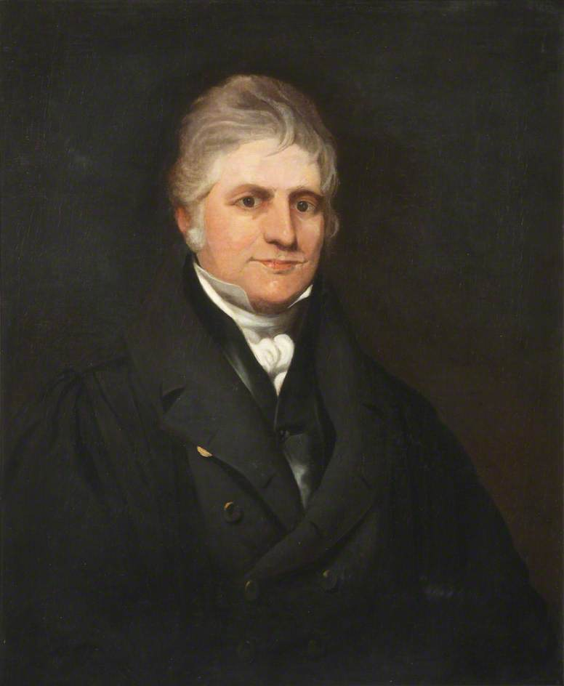
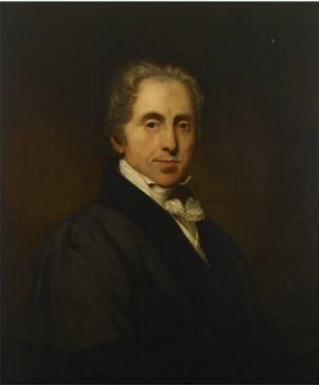
Natural History Museum
The Duncans

Slide 14
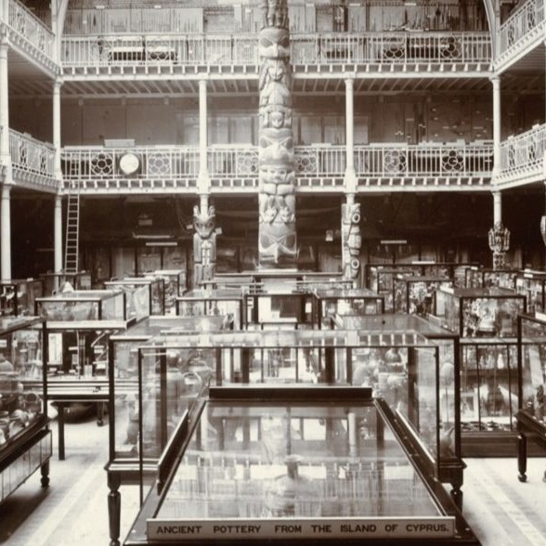
Zoological and Botanical Collections
Oxford University Museum Of Natural History 1855
Ethnographic Collections
Expansion phase since 1820s
Pitt River Museum 1886

Slide 15
Chaos
A natural history museum the collections had been transferred to other museums.
The lower floor housed some art and archaeology,
but the upper floor was being used for university functions.

Slide 16
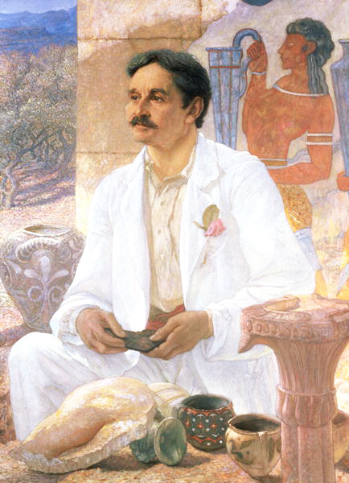
Change in the Ashmolean
Sir Arthur Evans (1851-1941)
Excavations at Knossos & Developing the concept of Minoan civilization
Knighted 1911
Keeper of Ashmolean museum in 1884-1901

Slide 17
Sir Arthur Evans’ Contribution
New direction— Archaeology Museum The Ashmolean as a Home of Archaeology in Oxford (Evans, 1884)
Persuaded Charles Drury Edward Fortnum Fortnum’s collections & Donations £10,000
Aegean World The most comprehensive Mycenaean and Cycladic collections outside Greece
Heberden Coin Room The Bodleian’s collection of coins
New Ashmolean Museum 1894 Moved the collection from Broad Street to Beaumont Street 1908 Old Ashmolean and University Art Galleries combined, create the current Ashmolean Museum of Art and Archaeology.

Slide 18
Early 1600s
The Picture Gallery in the Bodeian
1755 the Arundel Collection of Greek and Rome Marble
1845 Charles Cockerell
Neo-classical building
Shared with Taylor Institution
The University Galleries

Slide 20
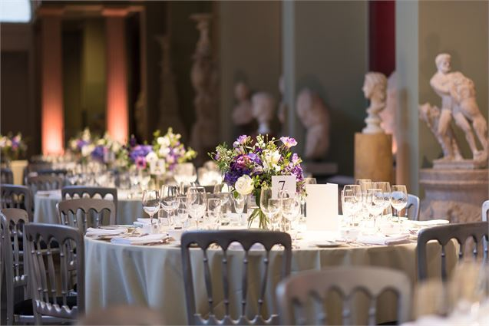

Slide 21
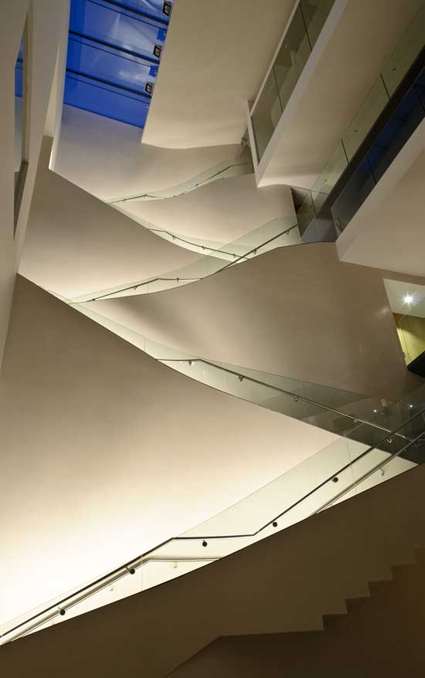
The Ashmolean Museum of Art and Archaeology
Architect Rick Mather Design 2009

Slide 22
Crossing Cultures Crossing Time

Slide 23
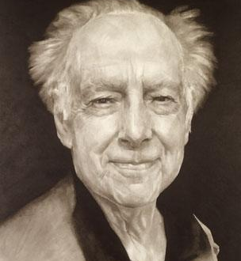
Modern Chinses Art
Michael Sullivan 蘇立文 (10/29/1916－29/09/2013)
最早向西方介绍中国现代美术的西方学者之一 20世纪美术领域的马可·波罗
《20世纪中国艺术与艺术家》

Slide 24
Directorate Dr Alexander Sturgis
Operations
Visitor Experience Museum Service Security and Health &Safety
Commercial
Publications & Licencing Picture Library Photography Retail Events
Collections Antiquities Eastern Art Western Art Heberden Coin Room Cast Gallery Digital Collection Conservation
Public Engagement
Communications Design Exhibitions Registrars Education
Development
Fundraising Friends & patrons

Slide 25
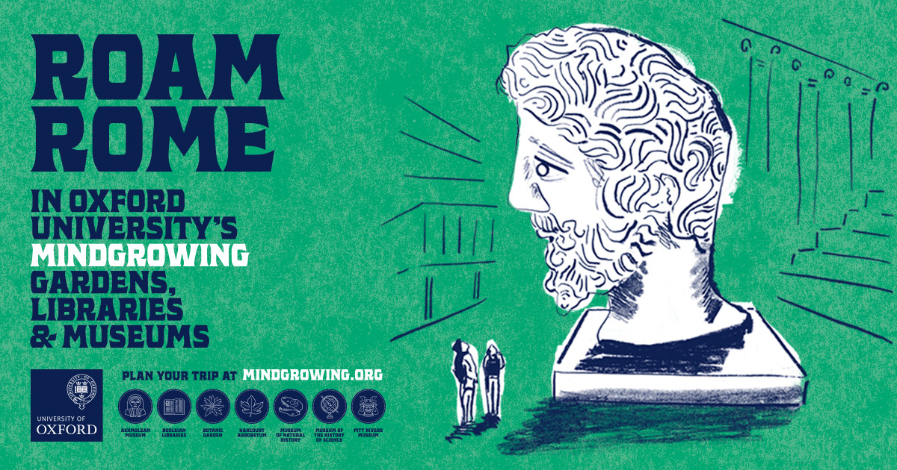
University of Oxford Gardens, Libraries and Museums
Ashmolean Museum Bodleian Libraries Botanic Garden & Harcourt Arbretum Museum of Natural History Museum of the History of Science Pitt Rivers Museum

Slide 26
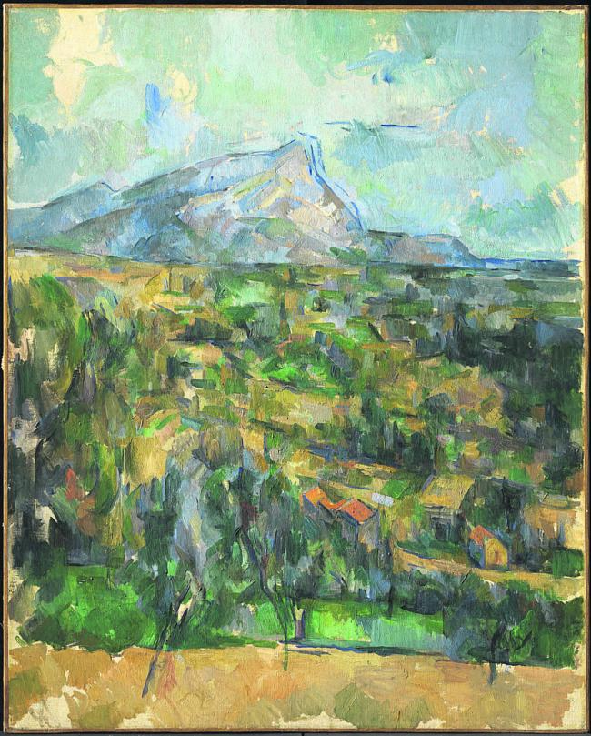
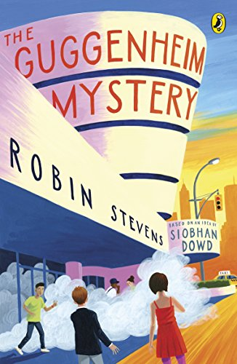
30/12/1999 —Cezanne painting stolen
£3 million
Pre-planned, well executed burglary
Entered the building through a skylight on the roof
Siobhan Dowd (2012)
Inspired by her mother’s experience in the Ashmolean

Slide 27
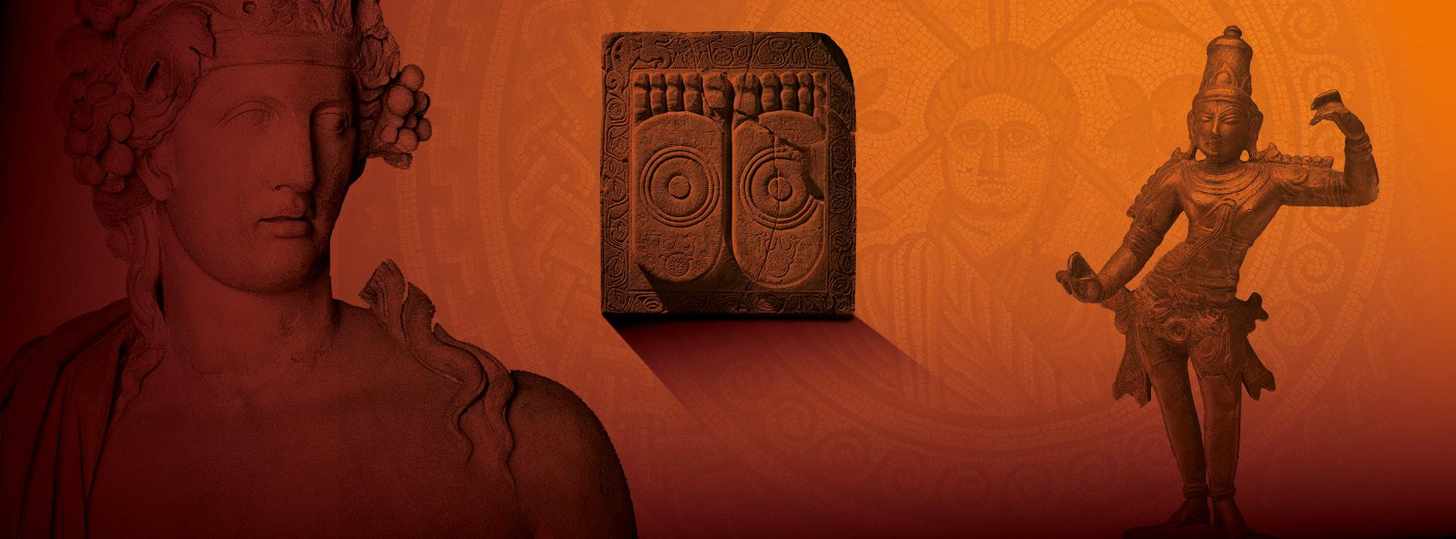
A five-year (2013-2017) humanities research project funded by the Leverhulme Trust and jointly hosted by the British Museum and Oxford University.

Slide 28
Roast Time
吐槽时间

Slide 29
